Slide 1
The internet of things(IoP)
BY Zimkhitha Mbasane

Slide 2
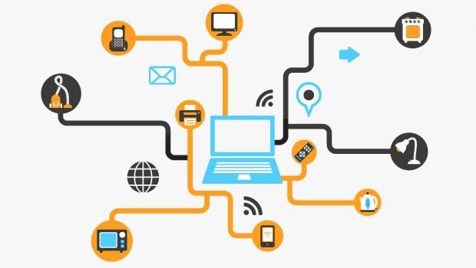
THE INTERNET OF THINGS
What is the internet of things?
The IoT is a new concept that has growth complex. The Internet of Things is the internet-able nature of modern physical devices, vehicles, and buildings etc. The IoT is a giant network of connected things and people all of which collect and share data about the way they are used and about the environment around them.

Slide 3
2. What is the Historory of IoT?
History of IoT
Kevin Ashton coined the phrase 'Internet of Things' in 1999, although it took at least another decade for the technology to catch up with the vision. The main concept of a network of smart devices was discussed as early as 1982, with a modified Coca-Cola vending machine at Carnegie Mellon University becoming the first Internet-connected appliance, able to report its inventory and whether newly loaded drinks were cold or not. Between 1993 and 1997, several cong the Internet of things as "simply the point in time when more 'things or objects' were connected to the Internet than people", Cisco Systems estimated that the IoT was "born" between 2008 and 2009, with the things/people ratio growing from 0.08 in 2003 to 1.84 in 2010mpanies proposed solutions like Microsoft's at Work or Novell's NEST.

Slide 4
3. What Technologies enable IoT?
Technologies that enable IoT
IoT is enabled by several technologies including:
Wireless Sensor Networks
Cloud Computing
Big Data Analytics
Embedded Systems
Security Protocols
Architectures
Communication Protocols
Web Services
Mobile Internet
Semantic Search engines

Slide 5
4 What is its impact?
The positive impact of the IoT on citizens, businesses and governments will be significant, ranging from helping governments reduce healthcare costs and improving quality of life, to reducing carbon footprints, increasing access to education in remote underserved communities, and improving transportation safety. As the sensors, data storage, the Internet, and analytics become faster, cheaper, better, and more integrated together, users will be able to rely on analytics to make better choices. IoT devices will have a significant impact on many aspects of our lives including how we live, drive, and farm animals and crops.

Slide 6
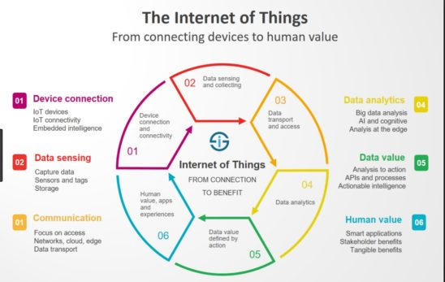
5. What is its impact going to be in the future?
The Internet of Things (IoT) industry is growing rapidly with the number of IoT-connected devices projected to surpass 20 billion by 2020. It’s an amazing number, but a number that wouldn’t be possible without the concurrent growth and availability of Wi-Fi and cellular. When you try to comprehend by the end of the decade there will be approximately 30 billion devices included in the IoT, and then five years later, in 2025, 75 billion will be connected, well, its mind boggling. The future is bright, and we believe that the Internet of Things will have a great impact on all of that.

Slide 7
References
Z Mbasane,Port Elizabeth, Motherwell, 6211
zmbasane@gmail.com
Contact 0736284789

